Slide 1
An Economic Overview of Latino Businesses in America

Slide 2
Latinos
are the engine of America’s
future economic growth.
Latinos create businesses three times faster than any other group in the United States (The Poynter Institute).
Latinas create businesses six times faster than any other group in the United States (Latino Community Foundation).
From 2007 to 2012, 86% of new small businesses in the United States were U.S. Latino owned (CNBC).
Latinos represent over 63.5 million residents in America today, comprising 1 out of every 5 Americans (Pew Research Center).
Latinos contribute nearly $2.8 trillion to the U.S. Gross Domestic Product (GDP) each year (Latino Donor Collaborative).

Slide 3
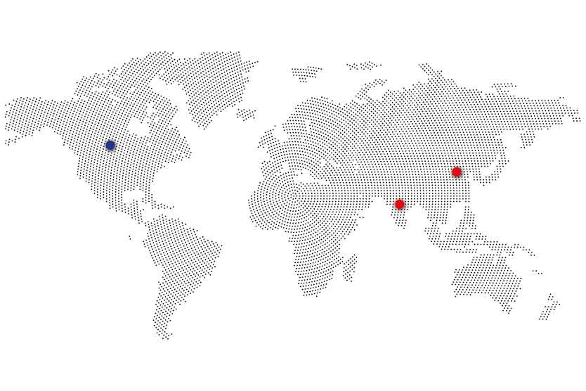
Latinos
are the engine of America’s
future economic growth.
The U.S. has a population of
335 million
as of 2022 (Worldometer).
The U.S. population is equivalent to
4.25 %
of the total global population (Worldometer).
The U.S. is 3rd
in size by population in the world
#1 is China (1.4 billion)
#2 is India (1.3 billion) (U.S. Census).

Slide 4
Latinos
are the engine of America’s
future economic growth.
More than
1 million
immigrants arrive in the U.S. each year (Pew Research Center).
The U.S. Fertility Rate in 2022 is
1,782 births per woman,
a total fertility rate of 2.1 children per woman is needed to ensure a stable population (Macrotrends).
Fewer U.S. births will spell
workforce challenges
for our nation’s economy.
If we were our own country, U.S. Latinos would represent the
5th largest economy
in the world (Worldnews).

Slide 5
State of Latino Businesses
According to the World Bank, the U.S. GDP is #1 in the world at $23 Trillion (Worldbank).
To keep our #1 ranking, we need an available, skilled, and educated workforce with equity and diversity.
335,326,930 – Current U.S. population (Worldometer).
At least 63,500,000 self identify as Latino (Pew Research Center).
Two thirds or 40 million Latinos were born in the U.S. (New America Economy).
Latinos represent more than 18% of the total U.S. population (Pew Research Center).
These facts are often lost in today’s noisy political environment.

Slide 6
State of Latino Businesses
The Economic Impact:
Latinos are the economic engine of the U.S. economy.
Latinos will be 75% of the labor growth in the next ten years (Nielsen).
80% of U.S. jobs are created by small businesses (JP Morgan Chase Institute).
Half of Latinos live in Texas, Florida, California, New York, and Arizona – the other half live throughout the country (Pew Research Center).
Today, the fastest-growing Latino communities are in: North Dakota, Alabama, Georgia, Pennsylvania, Louisiana, South Dakota, and Utah (Pew Research Center).
Latinos start more businesses per capita than any other racial or ethnic group in the United States (McKinsey).
The Latino population in the United States is expected to double in 40 years, from 63.5 million in 2020 to 128.8 million in 2060 (U.S. Census).

Slide 7
State of Latino Businesses
Today, one out of every ten jobs in America is created by an immigrant-owned business (National Immigration Forum).
43% of Fortune 500 Companies in the U.S. were started by an immigrant or the son or daughter of an immigrant (Brookings.edu).
Today, Latinos account for one out of every five workers in the U.S. (U.S. Department of Labor).
68% of Latinos are in the U.S. workforce, compared to 63% Anglos and 62% African Americans (U.S. Bureau of Labor Statistics).

Slide 8
State of Latino Businesses
High school dropout rates for Latinos have fallen, from 32% in 2000 to less than 6% in 2019 (Statista).
Latinos who enroll in college graduate at a higher percentage rate than Anglos and or African Americans (Pew Research Center).
In 2020, Latinos made up 30 million voters in the United States, the lowest registration and voting rate among major racial and ethnic groups in the country (NBC News).
One million Latinos will turn 18 in 2021 and every year for the next 20 years (Latino Donor Collaborative).
Education is the great equalizer and solution to achieve the American Dream.

Slide 9
Defining Latino Business Advocacy Priorities

Slide 10
Our Community’s Business Priorities
Access to Capital and Credit Education
The Need for Private Sector and Federal Procurement Contracts
Access to Technical Assistance and Capacity Building
Latinos and the Digital Divide: Access to Broadband, Wi-Fi, and Technology
Investing in the Future: Job Training and Workforce Development
Bipartisan Infrastructure Law

Slide 11
1. Access to Capital and Credit Education
Out of all the money appropriated by Congress through CARES Act for the Paycheck Protection Program (PPP) economic relief loans, 65% of the program’s loan dollars went to majority-white neighborhoods, 5% went to majority-Black neighborhoods and 8%went to majority-Latino neighborhoods (The Business Journals).
If we provided the capital for Latino companies to scale up, we would add another $1.47 trillion to the U.S. economy through jobs created, etc. (The Aspen Institute).
Latino entrepreneurs disproportionately could not access PPP forgivable loans due to the lack of information on the program, a complicated application process, and limited outreach.

Slide 12
2. The Need for Private Sector and Federal Procurement Contracts
By any measure, Latinos are the least represented on corporate boards, yet are the second largest population group, totaling 62.1 million Americans and contributing $9 billion to the economy year-over-year (Latino Corporate Directors Association).
Latinos hold only 4.4% of seats in the boardroom of the Fortune 500 companies, which does not reflect the population’s purchasing power from these companies (Latino Corporate Directors Association).
Ten years ago, 87% of Fortune 1000 companies lacked US Latino directors. Today, approximately 65% lack a Latino on the board. Today, less than 50% of Fortune 100 companies lack a Latino on the board of directors (Latino Corporate Directors Association).
Latinas continue to be least represented with 1% of board seats on the Fortune 500; the lowest number of seats of any gender or major ethnic group (Latino Corporate Directors Association).

Slide 13
3. Access to Technical Assistance and Capacity Building
Out of the five million Latino owned businesses, only three percent have scaled over $1 million in annual sales. There is much room to grow as it relates to contracting awards by Fortune 500 companies to Latino owned businesses (Hispanic Small Business).
Because most Latino businesses are small, they often do not have access to financial and human capital to increase production capacity (inBusiness).
97% of Fortune 500 companies have set percentage or dollar goals on supplier diversity, and 91% have a written company policy to include women and minority-owned businesses (The Philadelphia Citizen).
For members of the Billion Dollar Roundtable (BDR), Tier I diverse spend has hovered between 11.5 and 12% of the total U.S. procurement spend (Billion Dollar Roundtable).

Slide 14
4. Latinos and the Digital Divide:
Access to Broadband, Wi-Fi, and Technology
There is a digital divide between Latinos and non-Latinos in the United States because of a lack of reliable access to internet and high-speed broadband (Panoramas).
80% of Latino adults say they access the internet via a mobile device such as a cellphone or tablet at least occasionally (Pew Research Center).
It is much harder to access job applications, medical records, and do homework on a smartphone.
84% of Latinos in America are not able to work remotely or from home due to their job or profession (Economic Policy Institute).

Slide 15
5. Investing in the Future:
Job Training and Workforce Development
U.S. Latinos are the second fastest growing ethnic group by percentage in the U.S., after Asian Americans, according to the American Journal of Human Genetics (Latino).
By 2050, one out of every three jobs in the U.S. will be held by a Latino. (Pew Research Center).
The median age for Latinos is 30 – among the youngest ethnic groups in the United States. Latinos represent the present and future workforce of America (Pew Research Center).

Slide 16
6. Bipartisan Infrastructure Law
The U.S. Government’s federal funding model for this legislation is deeply rooted in funneling federal funding to state, local, and tribal governments with a separate focus on rural communities. Localism is committed to working with advocates and social impact organizations in the top ten states receiving federal funds to enact infrastructure projects related to this law and therefore create synergies for Latino-owned businesses to leverage new contracting/procurement opportunities.
Action Items:
Localism to setup meetings with The White House Office of Infrastructure Implementation, Department of Transportation, and economic development offices in the states listed here.
Localism to survey and engage national Latino chamber networks to get a market read for how local chambers are responding and advocating for Latino businesses to be a part of infrastructure projects being considered for implementation in their respective states.
Infrastructure Resources:
https://www.whitehouse.gov/build/maps-of-progress/
https://www.whitehouse.gov/wp-content/uploads/2022/05/BUILDING-A-BETTER-AMERICA-V2.pdf
https://www.whitehouse.gov/briefing-room/statements-releases/2022/05/16/fact-sheet-biden-harris-administration-hits-the-ground-running-to-build-a-better-america-six-months-into-infrastructure-implementation/
https://d2d.gsa.gov/report/bipartisan-infrastructure-law-bil-maps-dashboard

Slide 17
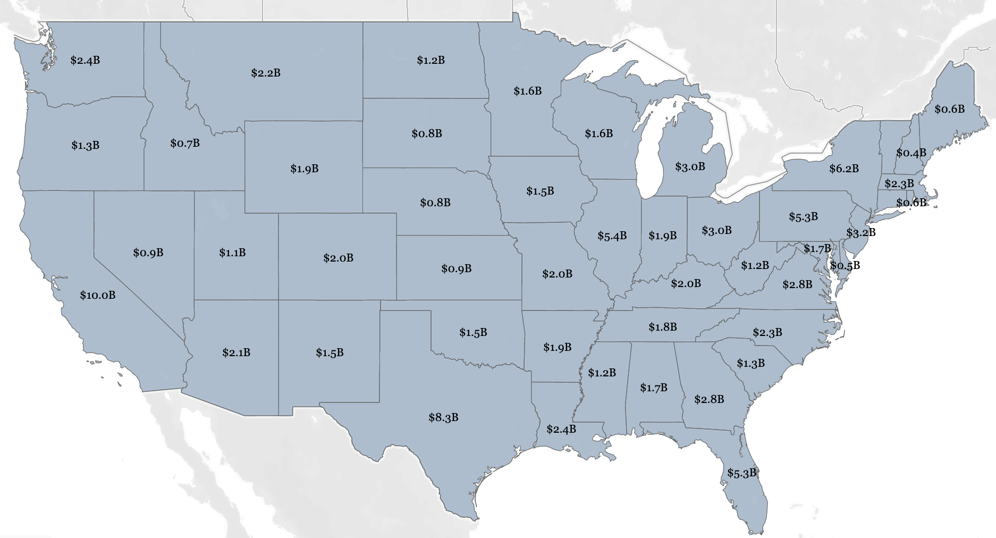
6. Bipartisan Infrastructure Law
The Top Ten Funded States:
California - $10B
Texas - $8.3B
New York - $6.2B
Illinois - $5.4B
Pennsylvania – $5.3B
Florida - $5.2B
New Jersey – $3.2B
Ohio - $3B
Michigan - $3B
Georgia – $2.8B
Total = $52.4 Billion

Slide 18
Contact:
LeRoy Cavazos-Reyna, MPA
Founder and CEO
P: 210-802-2126
C: 956-844-9628

Slide 19
Because at the end of the day, everything is local.

